Slide 1

Predicting Housing Prices
in Ames, Iowa
A presentation from Room 6
May Gee | Jia Wen | Chee Tzen | Hong Aik | Nazira
Notes:
MG:
Good morning instructors, TAs and fellow classmates. Today, me and my team will be bringing you through our project on analysing house prices in Ames, Iowa.

Slide 2

Background
Housing is commonly seen as an investment tool to flip for handsome profits.
Homebuyers (primary stakeholder) are keen to identify features which the value of the house is sensitive to in order to maximise capital appreciation.
Homeowners (secondary stakeholder) may also want to renovate their houses to improve its marketability.
Notes:
MG:
In many places, especially in cities, housing is commonly seen as an investment tool to flip for handsome profits. Homebuyers are keen to know which features of a house are highly sought after, in order to maximise future capital appreciation.
Homeowners may also want to renovate their houses to improve its resale value.

Slide 3
Problem Statement
How can homebuyers in Ames identify houses which have great appreciation value? How can homeowners in Ames improve their house values?
Using a dataset of housing prices in Ames, we have built a regression model to predict housing prices given its features, and in the process identify features which significantly affect housing prices.
Evaluation of the model will be done via root-mean-squared-error (RMSE), which is the average difference between the predicted SalePrice and the actual SalePrice.
Notes:
MG:
Our project thus aims to answer the following questions: How can homebuyers in Ames identify houses which have great appreciation value? How can homeowners in Ames improve their house values?
Using a dataset of housing prices in Ames, we have built a regression model to predict housing prices given its features and in the process identify features which significantly affect housing prices.
Our model will be optimised and evaluated via root means squared error, or RMSE, which is the average difference between the predicted and actual SalePrice. Lower RMSE scores are more favourable, as it shows that our model’s predictions are closer to the true saleprice.

Slide 4
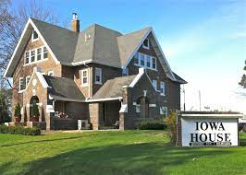
Data Source
Data was taken from Kaggle: https://www.kaggle.com/c/dsi-us-11-project-2-regression-challenge/data
2051
80
Number of houses
Number of house features
Notes:
MG:
Our model was trained on a dataset from Kaggle at the following website, which consists of 2051 sold houses in Ames. Each of these houses have 80 features that we will leverage upon to find patterns and correlations.

Slide 5
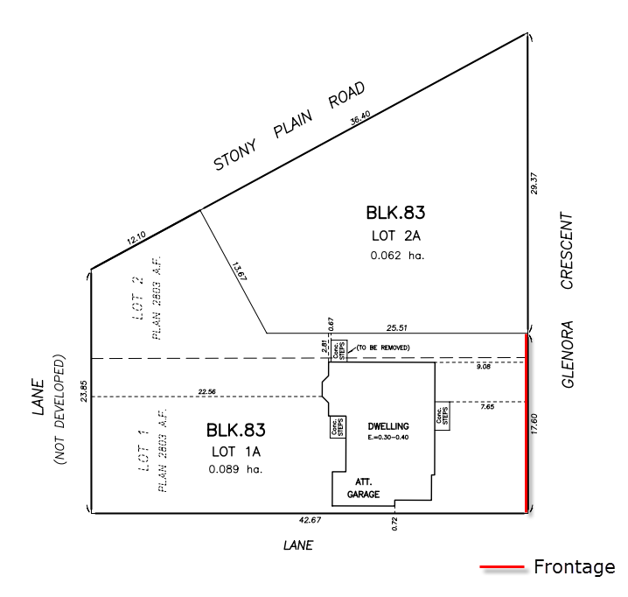

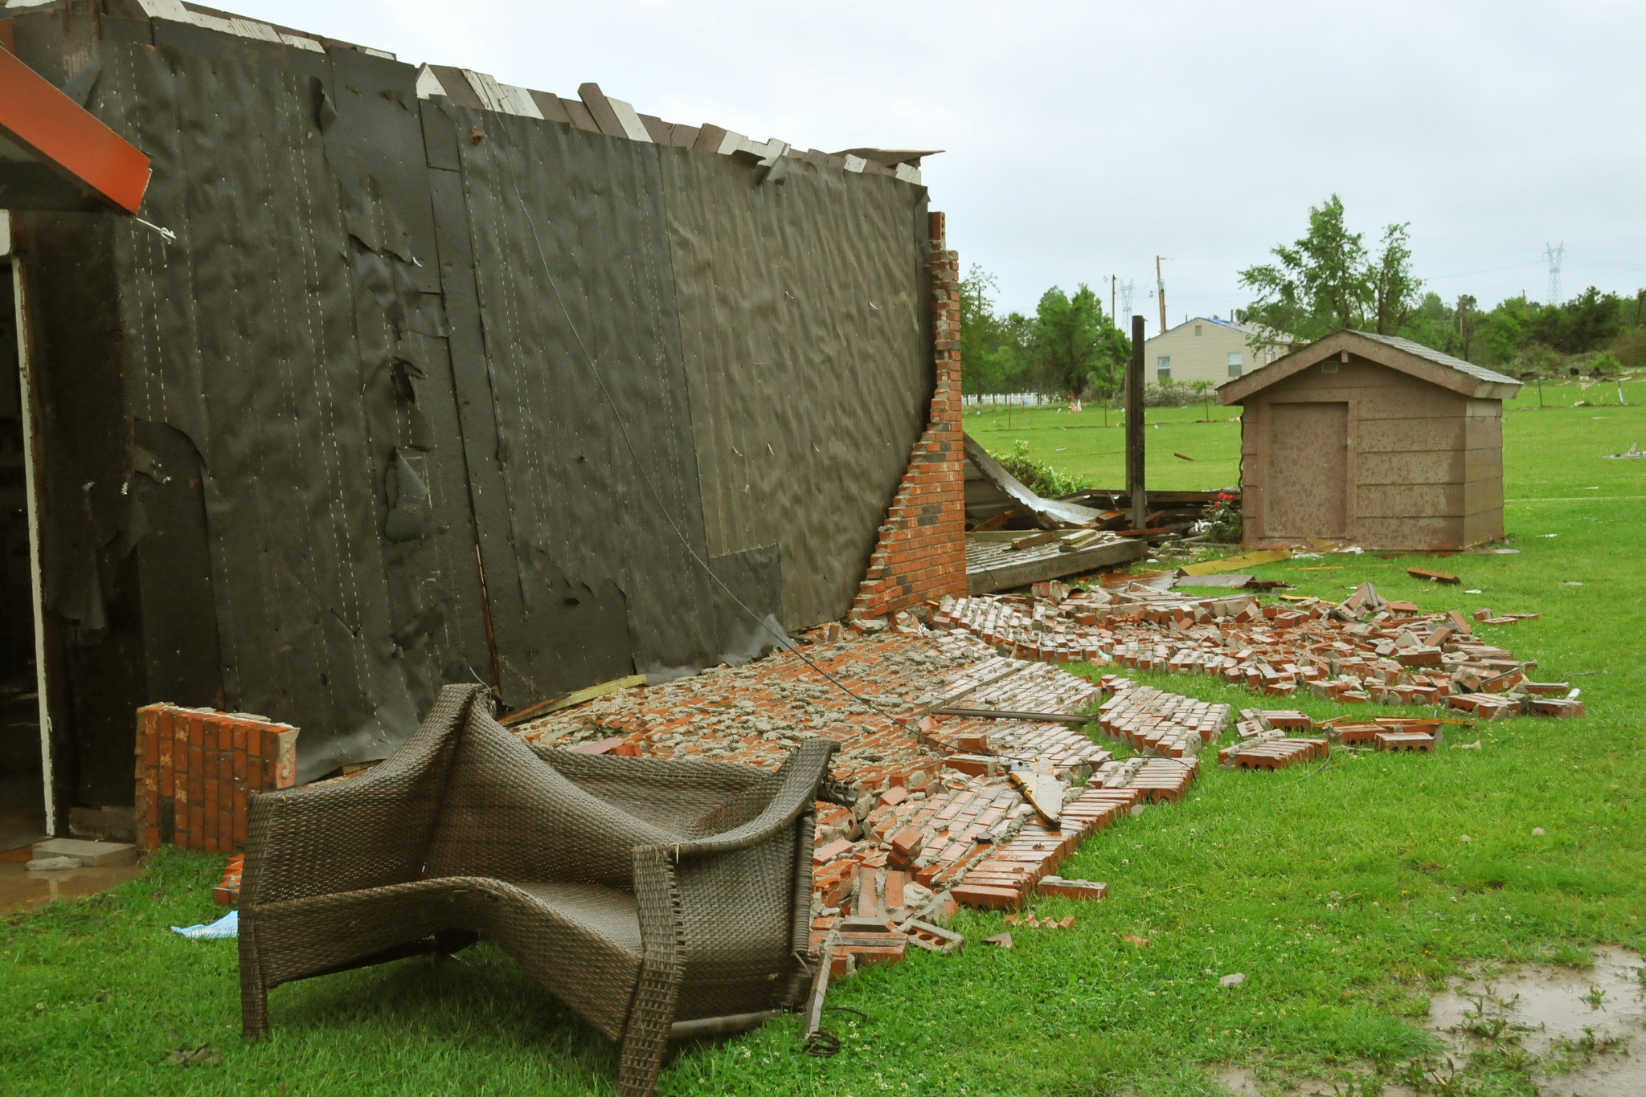
Data Source
Number of fireplaces
Type of masonry veneer wall
Lot Area/Frontage
Notes:
CT:
Some of the features in the dataset include the number of fireplaces, the type and area of masonry veneer wall, as well as the lot area and frontage. One observation we made about the dataset is that the features we used are mostly interior ones as shown here.
We believe that house prices can also be significantly influenced by other external factors such as demographics of the neighborhood, crime rate, distance to amenities such as public transport and airport and distance to public facilities. However, these information are not available, presumably due to the context of the population where such factors are less valued. This is of course, in stark contrast with the Singapore context.

Slide 6


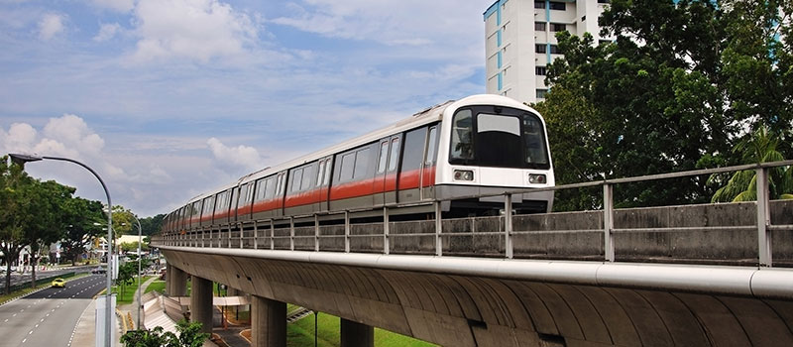
In Singapore…
Notes:
CT:
In Singapore, we know that housing prices are significantly affected factors such as
1) convenience, whether it’s near an MRT station, or shopping centre, or isit in a prime location,
2) and distance to reputable schools is an important factor for parents as well.
And of course housing features like the size of unit and which floor your unit is located, for example in a block, units in the higher floor units can be much more expensive than units at a lower floor

Slide 7
In Ames…
Notes:
CT:
In our Ames dataset however, we only have data on the size and number of floors of the house, as well as many other features not commonly found in Singapore’s houses. Examples include fireplaces, masonry veneer walls, and garages.
Unlike houses in Ames which are mostly low-rise, Singapore houses are usually found in high-rise buildings, which is our as HDB flats, where one building may house hundreds of houses. It is then prudent to note that our model is unlikely to be extendable to Singapore’s context.

Slide 8
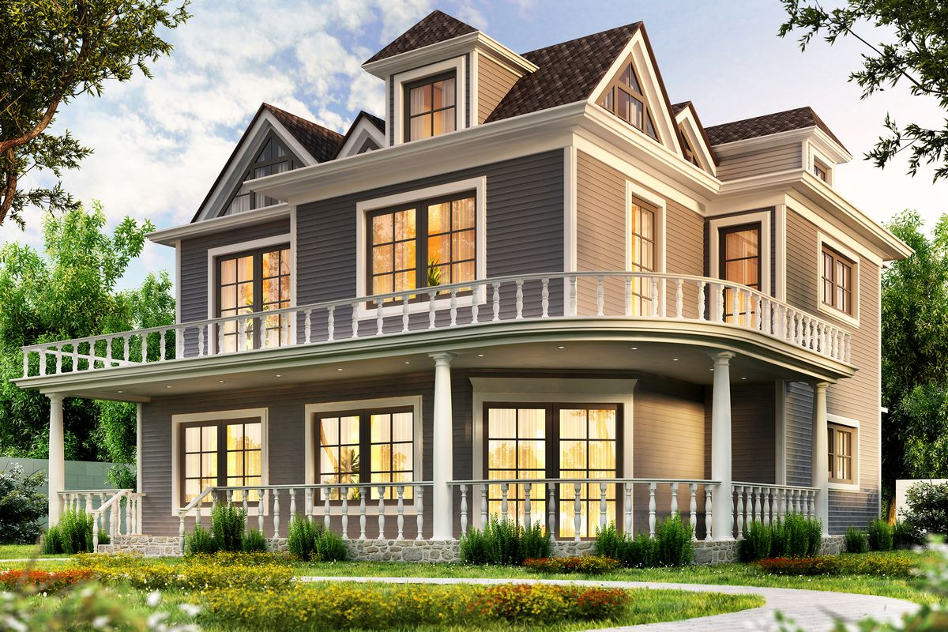

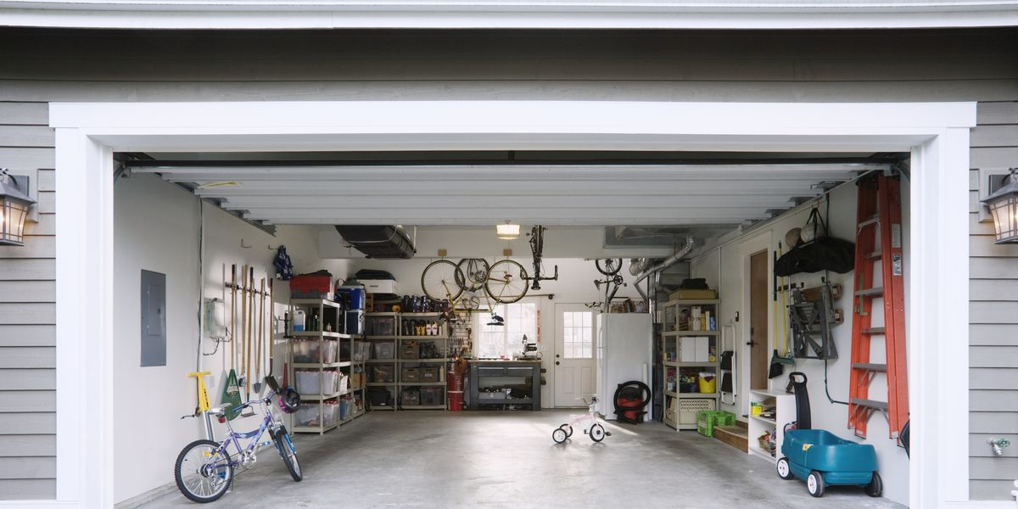
Data Exploration
Overall Qual (Rates the overall material and finish of the house): 0.80
Ground Living Area: 0.70
Garage Area: 0.65
Notes:
JW:
Next, we preliminarily explored some of the features of the houses which correlated with SalePrice. Correlation gives us a good indicator of which features are likely to be important, and its values range between 1 and -1. Values closer to 1 indicate stronger positive correlation while values closer to -1 indicate stronger negative correlation. Values close to 0 indicate no correlation.
Over here, we found that the top 3 features positively correlated with SalePrice are Overall Quality, Ground Living Area as well as Garage Area. In other words, these features, when present in greater magnitude, are likely to produce higher SalePrice. For example, a house with a higher Overall Quality would likely fetch a higher price than a house with a lower overall Quality.
The findings here are perhaps unsurprising as larger and better quality houses will naturally fetch better prices, except for Garage Area, which might be an unusual feature, especially in the Singapore context. We can postulate that Ames’ citizens may have a natural preference for large garages for some reason.

Slide 9
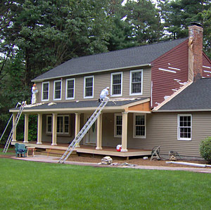
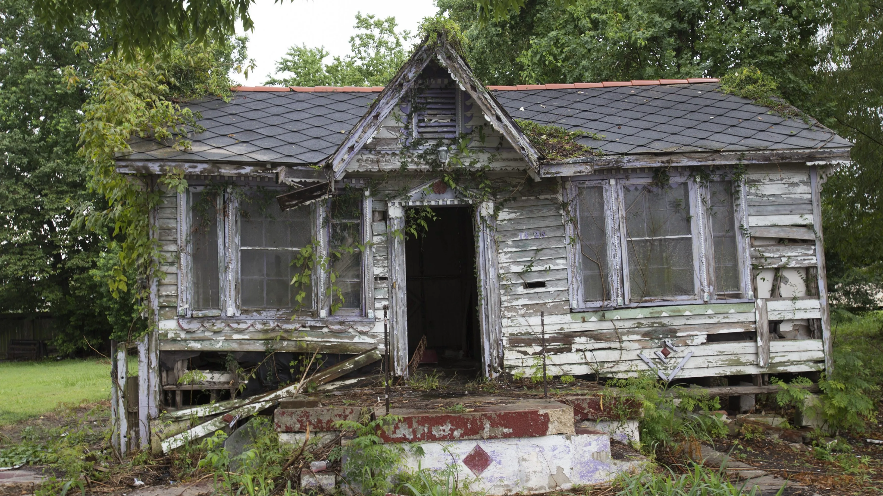
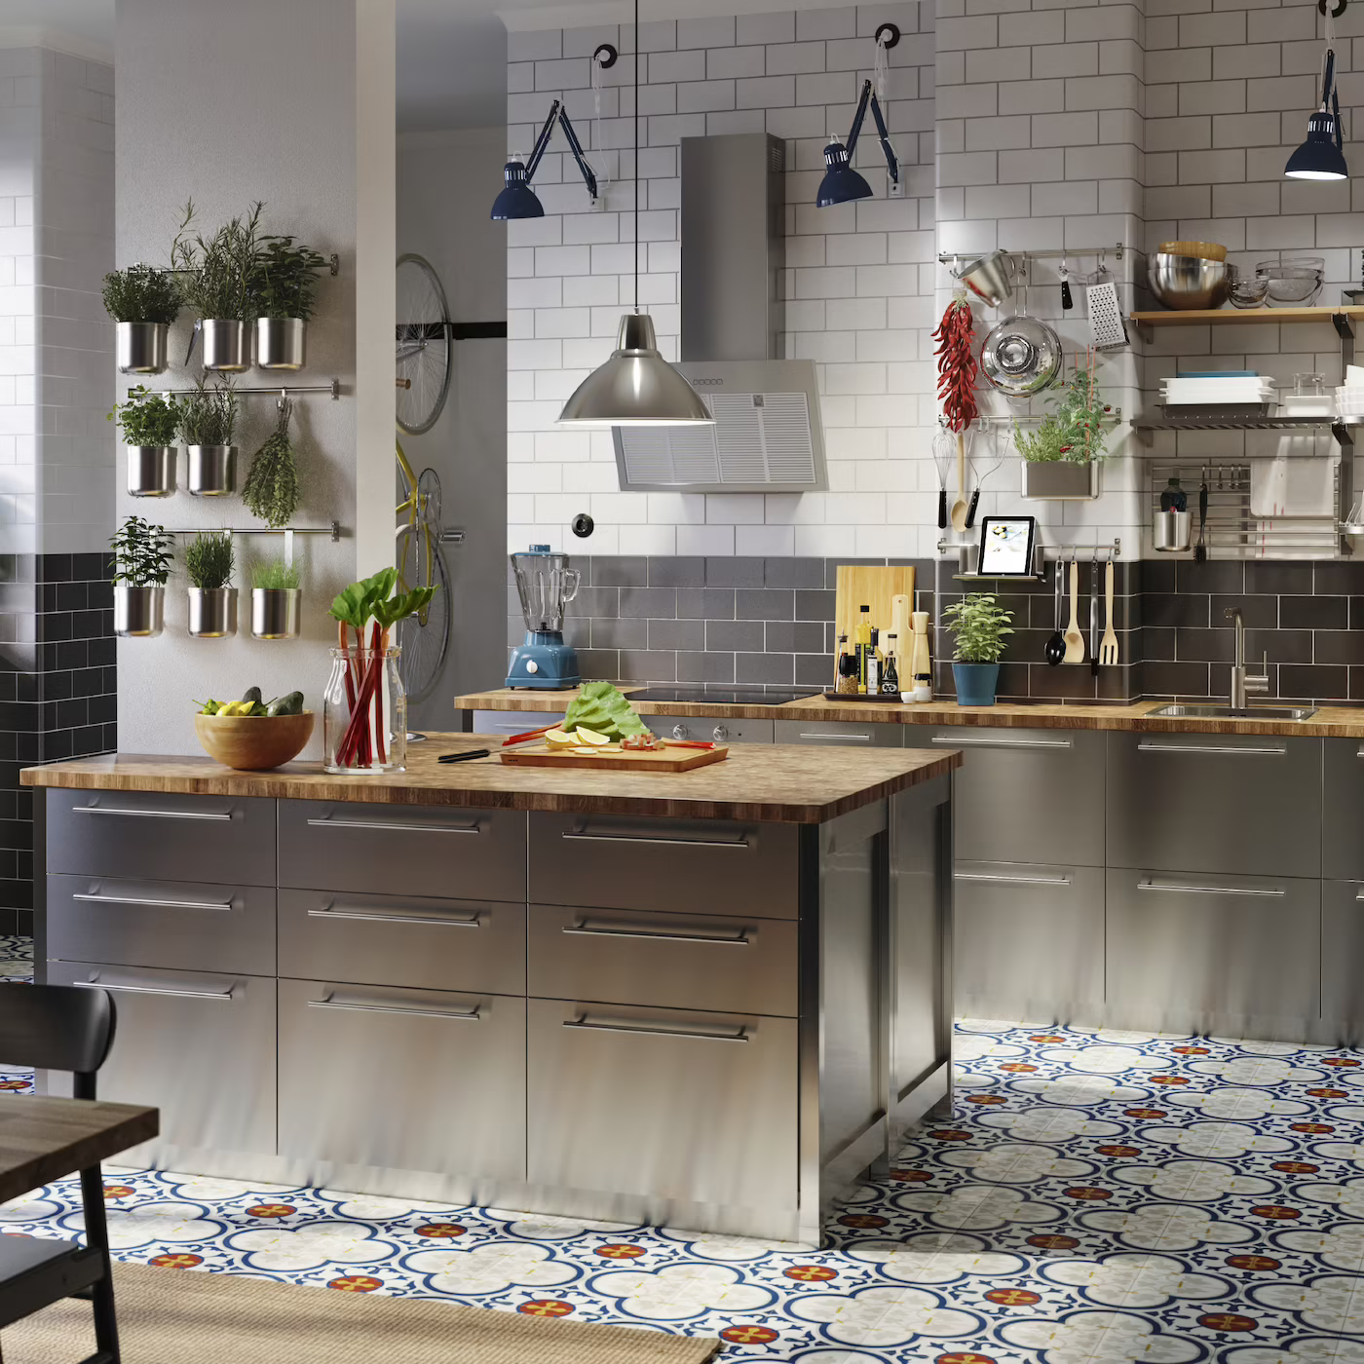
Data Exploration
Exterior Material Quality (Average/Typical): -0.60
Age of house as at sale: -0.57
Kitchen Quality (Average/Typical): -0.54
Notes:
JW:
Likewise, we found that the top 3 features that are negatively correlated with SalePrice are Exterior Material Quality, Age of house as at sale as well as Kitchen Quality. In other words, houses with such features are likely to fetch lower prices.
While age is unsurprising, the other two are somewhat unusual, because while it is plausible that Ames’ citizens for some reason emphasize greatly on the house’s exterior material and kitchens, the category of Average/Typical is strange. This implies that even houses with poor Exterior material or kitchen quality might somehow do better than houses with average exterior material or kitchen. One reason for this phenomenon could be that given the small size of our dataset (which only has slightly more than 2thousand houses), we do not have sufficient data points in the other categories to verify the correlation.
Next, I will pass the time over to Hong Aik, who will bring you thru the feature engineering process

Slide 10
Feature Engineering
Feature | Correlation
Overall Qual | 0.80
Ground Living Area | 0.70
Garage Area | 0.65
New Feature | Correlation
Overall Qual-Ground Living Area | 0.84
Overall Qual-Garage Cars | 0.82
Overall Qual-Garage Area | 0.81
Notes:
JW:
We also experimented with interaction terms, which are new features created by multiplying two existing features together. In doing so, we found that such features correlate even more strongly with SalePrice than the original individual features. As we can see, multiplying overall qual and ground living area results in a feature with 0.84 correlation, compared to 0.80 of overall qual alone.
Many of these new features would then be similar and have great overlap, however, our model employs a technique called Lasso regularisation which is able to systematically strip out the overlapping features and only retain the ones which are most important.

Slide 11
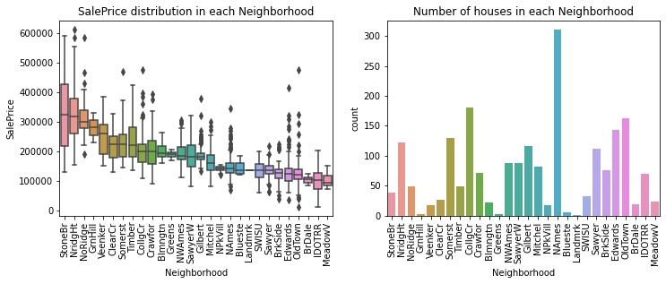
Feature Engineering
Group categorical columns into at most 4 categories based on
median SalePrice
number of observations
Class A Class B Class C Class D
Notes:
HA:
Besides multiplying terms together, we also grouped features with many categories such that there are a maximum of 4 categories per feature. Doing so reduces the number of features we end up with which improves model performance and reduce computing time.
While there are a few philosophies to follow when performing grouping, we have chosen to do so based on the data - to be precise - based on the median SalePrice and the number of observations. Using Neighborhood as an example, from the chart on the right, we can observe 4 distinct clusters of neighborhoods when arranged according to median SalePrice. We hence used this as a basis to group the neighborhoods into 4 groups.
Other methods one might consider include using geographical area, but as that data is not readily available, we opted to use this method instead.
All in all, after our feature engineering steps, we still ended up with a whopping 5151 features. Fortunately, our model is able to handle this.

Slide 12
Model Results
$20,468
~11%
Average error
Error Percentage of Mean SalePrice
Notes:
HA:
After testing a few models and optimizing its parameters, we landed on one which gave us the best performance, defined as the one with the lowest error in predictions.
With this model, the average difference between the model predictions and the true Saleprice is $20,468, which might seem alot, but this is about 11% of the average SalePrice. In other words, we can use this model to predict the true SalePrice of a house with a given set of features with an 11% margin of error.

Slide 13
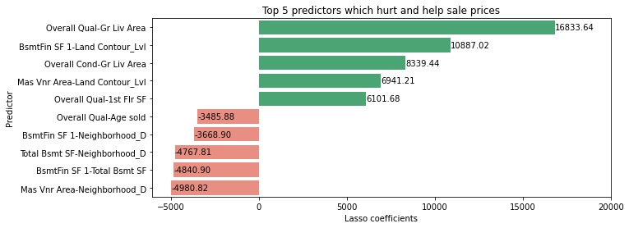
Insights from the Model
Notes:
HA:
Another advantage of the model is that we can tell specifically which features are significant in influencing the SalePrice. This is different from correlation, which only looks at two variables in silos.
At first glance, we observe that in the top 5 predictors which hurt and help SalePrice, all of them are our created features, indicating that these are more useful as opposed to the individual features alone. This is even the case for Overall Qual which showed strong correlation (0.8) with SalePrice
The labels on the bar charts are the coefficients of the feature, which translates to how a unit increase in that feature affects SalePrice. For example, a 1 unit increase in Overall Qual-Gr Liv Area would be expected to raise SalePrice by $16833, while 1 unit increase in Masonry Veneer Area-Neighborhood D is expected to depress SalePrice by $4980.
Based on the bottom 5 features, we see that Neighborhood D appears quite a few times, indicating that this cluster of neighborhoods (SWISU, Sawyer, BrkSide, Edwards, OldTown, BrDale, IDOTRR and MeadowV) is not doing well in terms of price appreciation. These neighborhoods could attract lower housing prices due to older houses (such as OldTown) or perhaps some local demographic properties of that neighborhood

Slide 14
Insights from the Model
Unique house features in top 5 predictors that improve house prices | Unique house features in top 5 predictors that hurt house prices
1st Floor Area | Neighborhood D
Basement Finished Area | Basement Finished Area
Overall Quality | Overall Quality
Land Contour (Near Flat) | Total Basement Area
Masonry Veneer Area | Masonry Veneer Area
Overall Condition | Age sold
Ground Living Area | -
Notes:
HA:
We next look at the unique features that are present in the top 5 predictors that improve and hurt house prices. We immediately notice that 3 of the features (highlighted) seem to contradict by appearing to both improve and hurt house prices.
However, given our model, we should bear in mind that the predictors are a combination of two features. For example, Masonry Veneer Area only hurts house prices when combined with Neighborhood D (go back to prev slide). In other words, when placed in another neighborhood, the effect on SalePrice will be different.
Another point to note is the magnitude of the coefficient. Masonry Veneer Area would appear to help SalePrice more than it hurts, given the coefficient of +6941 vs -4980, assuming that the house is also in neighborhood D and is situated on flat land.

Slide 15
Recommendations for Homeowners
Notes:
Naz:
Our model suggests to optimise two features simultaneously for the best results. For homeowners,
Improve on Overall Condition, Overall Quality, 1st Floor Area and Ground Living Area, since these are continuous variables.
Expand Basement Finished Area only if the house is situated on flat land (Land Contour)
Expand Masonry Veneer Area only if the house is situated on flat land (Land Contour)
If the house is in neighborhood D, reduce the areas of Basement Finished, Total Basement and Masonry Veneer
Minimise the Basement areas
Sell the house while it is still young

Slide 16
Recommendations for Homebuyers
Notes:
Naz:
For homebuyers:
Buy houses with good Overall Condition, Overall Quality, and large 1st Floor Area and Ground Living Area
If the house is situated on flat land, buy houses with small or no Basement Finished Area and Masonry Veneer Area, so that you can increase these aspects later on
If the house is in neighborhood D, avoid those with Basement Finished, Total Basement and Masonry Veneer Areas
Buy houses with small or no Basement areas
Buy houses which are young, since prices deteriorate with age

Slide 17
Model Caveats
Sensitive to context; unlikely to be generalizable. This is because two populations may not share the same “taste” for desirable features in a house
To make the model more generalizable, reduce the number of variables, at the expense of predictive power.
Notes:
Naz:
Our model is unlikely to be generalizable to other cities. Here, we used all 5000+ factors to determine house prices because we did not have enough domain knowledge to perform manual feature selection. In reality, two populations may not share the same "taste" for desirable features in a house. This is true across time and space. As our dataset is dated more than a decade ago and demographics shift, what Ames citizens used to find desirable then may not be so now. Similarly what Ames citizens find desirable in a house, Colo citizens may not agree. Colo is another city in Story County, Iowa.
To make the model more generalizable, we could cut down on the number of variables and use only general features found and assessed within most houses in the world, such as distance to a transport system. This would of course come at an expense of the predictive power of the model.

Slide 18
Possible Enhancements
Trial other predictive models (eg. RandomForest, Support Vector Machine)
Obtain more data, preferably recent
Obtain more general features of the house such as crime rate, ethnicity, distance to amenities or facilities
Notes:
Naz:
Other enhancements we could make to our model include:
Testing other predictive models such as random forest, support vector machines, since we are limited to only linear regression here
Obtaining more housing data, preferably recent, to update the model and expose it to more variations
Obtaining more general features of the house such as crime rate, ethnicity, distance to amenities or facilities

Slide 19
Thank You

Slide 20
Annex

Slide 21
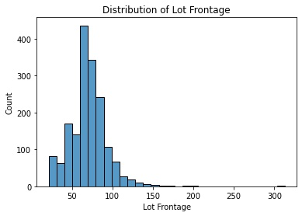
Lot Frontage

Slide 22
Ames Housing Dataset
Describes the sale of individual residential property in Ames, Iowa from 2006 to 2010
Dataset contains —
80* explanatory variables to access home values
*23 nominal (* example..), 23 ordinal (* example..), 14 discrete and 20 continuous
Variables are —
objective & quantitative (i.e. year built, number of fireplaces)
subjective & qualitative (i.e. heating quality, exterior quality)
Notes:
The Ames Housing dataset, which describes the sale of individual residential property in Ames, Iowa from 2006 to 2010. The dataset contains 2051 observations and a large number of explanatory variables (23 nominal, 23 ordinal, 14 discrete and 20 continuous) involved in accessing home values. These variables are therefore both objective/quantitative (year built, number of fireplaces) and a bit more subjective/qualitative (heating quality, exterior quality).

Slide 23

Data Cleaning (Handling Nulls)
01
Lot Frontage
Imputed with mean
02
Categorical features not present
→ imputed with a standard string
(eg. ‘No Garage’)
Related numerical features → imputed with 0
Columns related to
Masonry Veneer, Basement and Garage
03
Other columns
Null values have intended meanings,
→ imputed with standard string (eg. ‘No Fence’)

Slide 24
Data Cleaning (Dropping Columns)
Dropped Columns | Rationale
Id, PID, Sale Type | Not related to SalePrice
Year Built | Replaced with AgeSold
Year Remod/Add | Replaced with AgeRemodelled
Pool Area, Pool QC | Vast majority of houses have no pool
Notes:
Visualisation for PID/ID not related to sale price…

Slide 25
Data Cleaning (Dropping Columns)
Dropped Columns | Overwhelmingly Single Value | Rationale
Condition 2 | ‘Norm’ - 98.7% | near-zero variance ⇒ likely contain little valuable predictive information
Utilities | ‘AllPub’ - 99.9%
Roof Matl | ‘CompShg’ - 98.7%
Heating | ‘GasA’ - 98.3%
Misc Feature / Misc Val | ‘NA’ - 96.8%
3Ssn Porch | ‘0’ - 98.7%
Notes:
Visualization for these…this slide to be put as annex

Slide 26
Data Cleaning (High Cardinality Categorical Variable)
Group categorical columns into at most 4 categories based on
median SalePrice
number of observations
Class A Class B Class C Class D
Notes:
Reduce dimensionality -> reduce overfitting and computing time. Results are worse without grouping

Slide 27
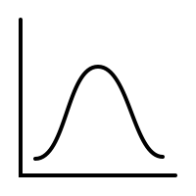
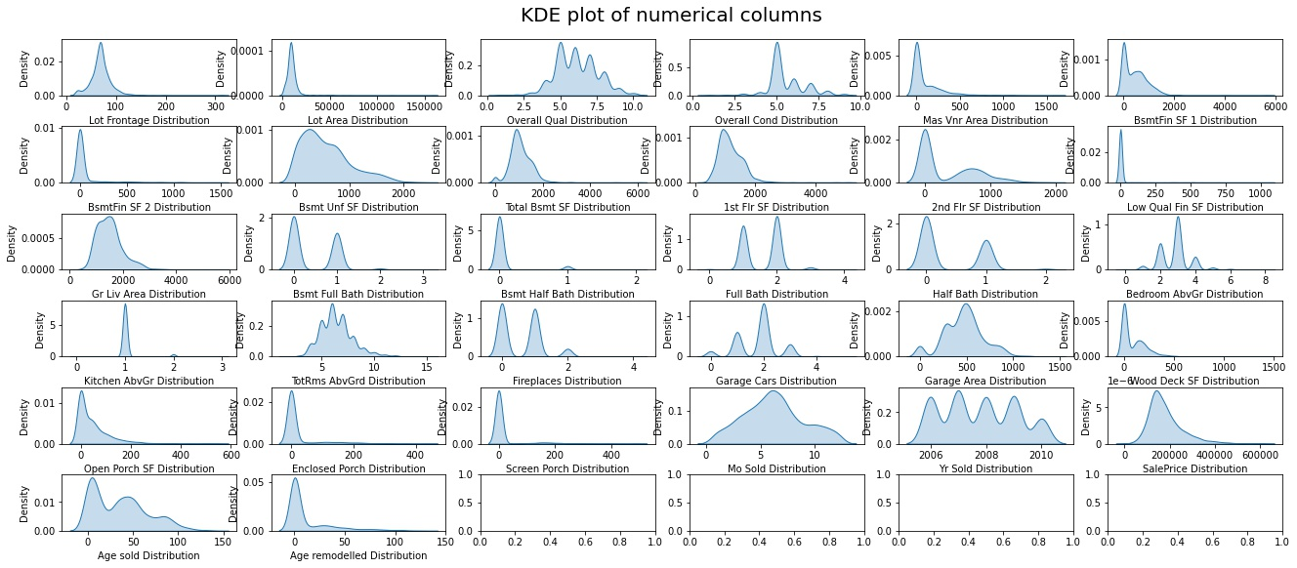
Data Cleaning (Numerical Columns)
normal

Slide 28
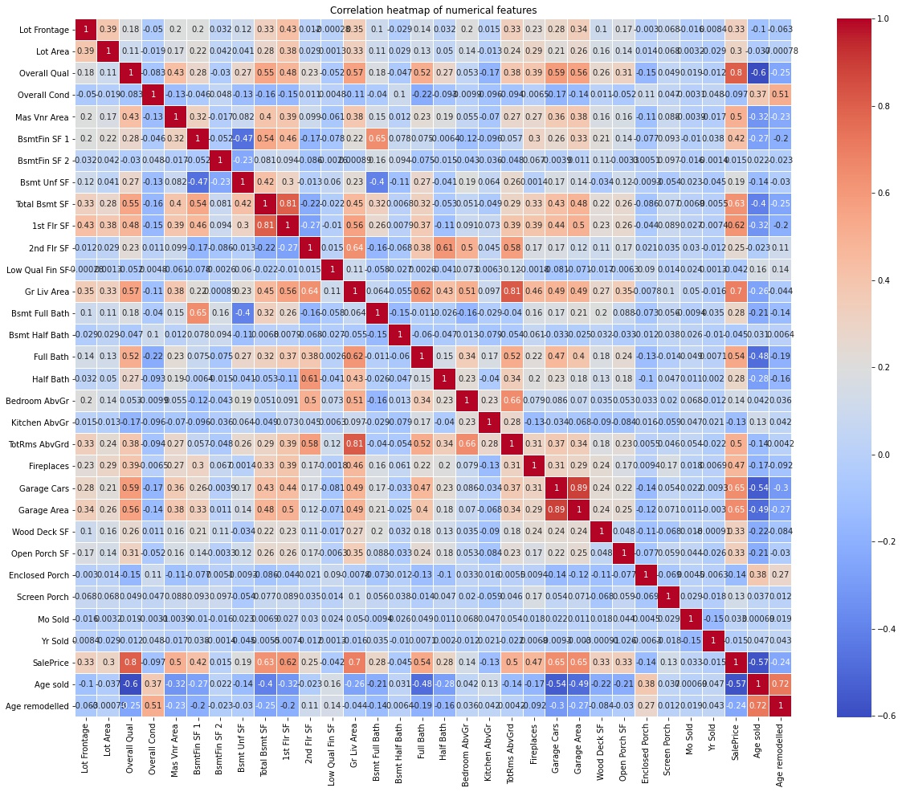
Exploratory Data Analysis
Most (numerical) features are not correlated with one another.
Instead of dropping related columns, we will leverage on interaction terms and regularization.
Notes:
After we have cleaned the data we explore the data from high level. As a start we extract all the numerical data and see their correlation with each other. We are not trying to pick which columns has the highest correlation with the sale price, but rather just have an overall view on how the columns are related to each other, so we didn’t really spend a lot of time to make the table pretty by masking the other side or any other stuff.
As shown here most of the numerical columns are not highly correlated with each other, only a handful are highly correlated, so instead of dropping the related columns,
we decided to preserve all information, however small and unlikely there is in the columns.
Another reason why we don’t select and drop some of the columns, is because we don’t really have sufficient domain knowledge to judge which columns to be dropped.
Because any we will use Regularization like Lasso at a later stage, and Lasso can help remove unnecessary features more systematically hence we don’t need to do it manually.
Since we do not have sufficient domain knowledge to manually select features, we can only rely on the model to help us do so.
What are interaction terms?

Slide 29


Model Preprocessing
PolynomialFeatures
Dummify X
train.csv
n_rows = 2051
n_cols = 81
X
(Predictors)
y
(SalePrice)
X_dummy
(Predictors)
X_poly
(Predictors)
X_train_scaled: (1845,5151)
X_test_scaled: (206,5151)
y_train: (1845,1)
y_test: (206,1)
X_train: (1845,5151)
X_test: (206,5151)
y_train: (1845,1)
y_test: (206,1)
StandardScaler
Train-test
split
Notes:
Train and tune hyperparameters on training set, evaluate model on unseen data using test set
Dummifying means creating 1 column for each category in to convert
Polynomial multiplying every possible features a,b,c, a*b, b*c,

Slide 30
Baseline Model
 | Train R² | Test R² | Train RMSE | Test RMSE
Linear Regression | 0.99999 | -2.1296e-15 | 65 | 3.5408e+12
Mean SalePrice | 0 | -0.00595 | 79492 | 76727
Baseline models, as expected, have performed poorly. Linear Regression has severely overfitted, while the null model has underfitted.

Slide 31
Model Selection
Model | Best alpha | Best L1 ratio | Train R² | Test R² | Train RMSE | Test RMSE
RidgeCV | 2364 | NA | 0.95942 | 0.92596 | 16,012 | 20,877
LassoCV | 497 | NA | 0.95688 | 0.92883 | 16,505 | 20,468
ElasticNetCV | 31 | 0.95 | 0.95511 | 0.92539 | 16,842 | 20,956
The lasso model has performed the best, which is heartening, because it also has the ability to “remove” unnecessary features (94%).
Notes:
Some overfitting, but remarkably small and acceptable given the large number of features. As a side note, we have also ran the same models on the same dataset without PolynomialFeatures, but the results are worse.

Slide 32
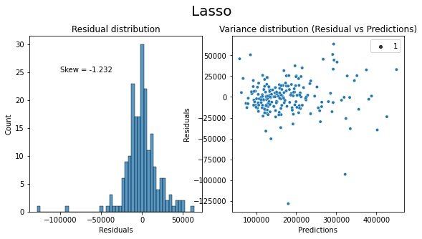
Testing Linearity Assumptions
While the skew value indicates a considerable amount of right skewness, there appears to be no discernible pattern in the residuals.
Hence, we can consider the assumptions satisfied.
Notes:
While not shown in this notebook, we have experimented with log transformations on the numerical columns, which resulted in even worse residual patterns and skew values.

Slide 33

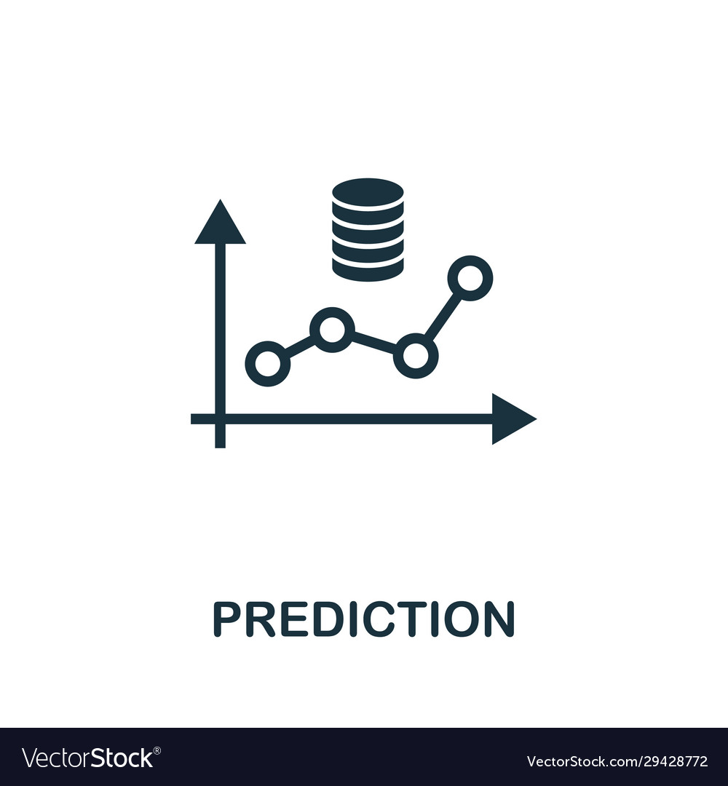
Stacking Models (only for Kaggle)
predict
Ridge
predict
average
Lasso
predict
Final Predictions
ElasticNet

